Slide 1
Rumour Register for UNICEF
Problem Statement:
Think of the ways to get the rumours spread on some disease registered for precautions and safety.
Team
Yogesh Jain
Tanya Nandwani

Slide 2
Motivation
To reduce the time that it takes to know about a new rapidly spreading disease to save life.
Top 10 deadliest epidemics in history
Polio, Camp fever, AIDS, Malaria, Cholera,
Smallpox, Yellow fever, the black death,Tuberclosis (TB) etc can now be monitored and controlled.
Coz we know “Precaution is better than cure”

Slide 3
Solution:
Here is the ways through which we can register rumours and spread awareness.
Rumour registration portal for users via website/app.
Analyzing the registered rumours by UNICEF officials via admin portal (dashboard).
Spreading precise awareness to public if rumour found valid along with symptoms and precautions.

Slide 4
Technology stack
Web interface [Website]: Development tools required:
HTML, CSS, JavaScript.
MySql,PHP.
Mobile application
Made in native android sdk.

Slide 5
Use Case
User Signup
Rumour
Register
In Admin Server
Survelliance by UNICEF
Spreading Awareness
Via Spreading techniques
Reporting to Radio Stations
Email Gateway
Social Media
SMS Gateway

Slide 6
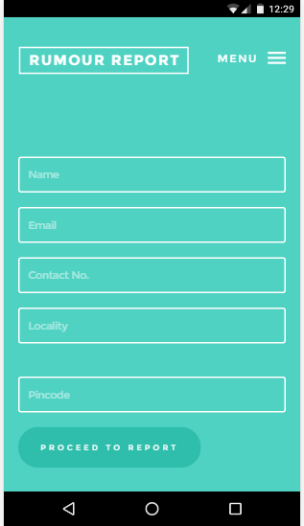
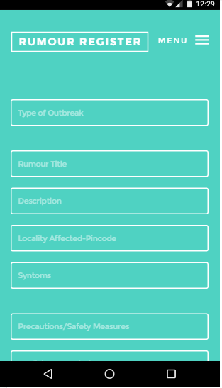
Rumour Register App/Webpage
Progress:95%

Slide 7
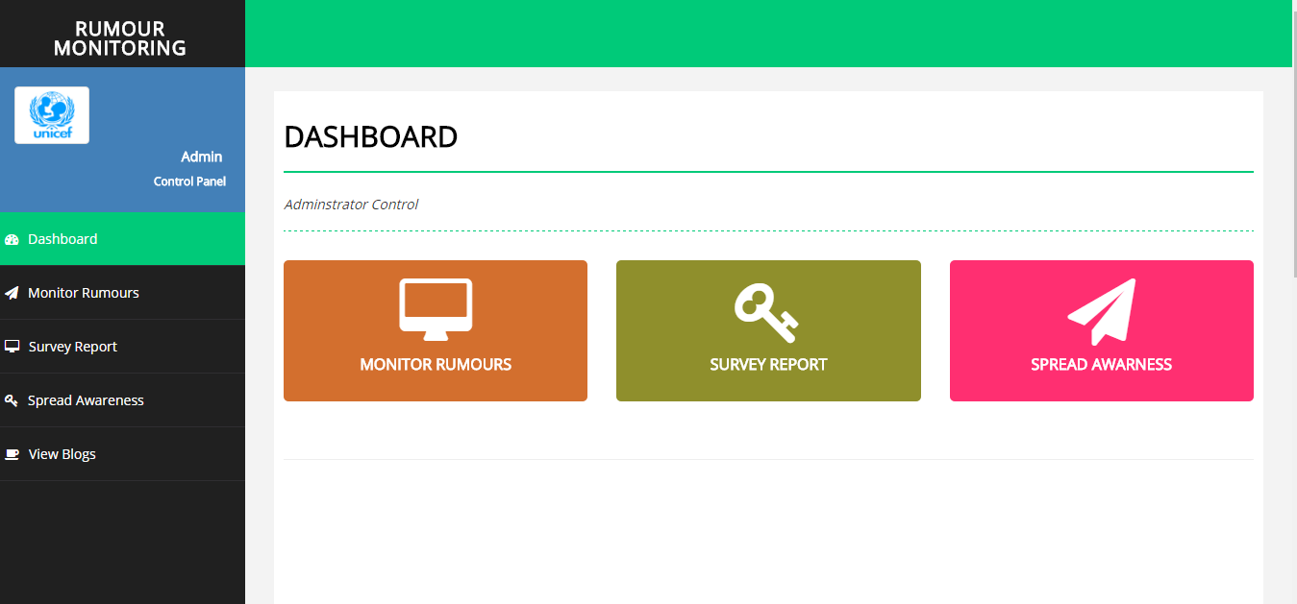
UNICEF Admin Dashboard

